Slide 1

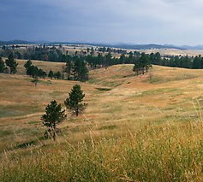
 | Lewiston Pistol Club, Inc Stage: Double Barricade Course Designer: Roger Watson
START POSITION:
GUN READY CONDITION: Loaded gun in holster, hands relaxed at sides. |  | SCORING: Comstock, 22 rounds, 70 points TARGETS: 5 IPSC, 3 PP, 2 USP, 7 Plates SCORED HITS: Best 2 per paper, KD steel = 1A START-STOP: Audible - Last shot RULES: USPSA current edition
STAGE PROCEDURE: Upon start signal, engage targets as required to score.
LPC
← 24’ →
← 24’ →
← 24’ →
Fault line
Fault line

